Slide 1

Project Arcade game………

Slide 2
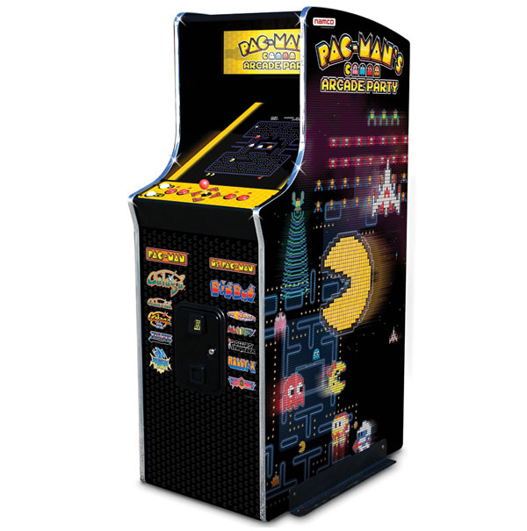
What to do
Within 2 weeks, create a 2d arcade game for the arcade machine in G.6.30

Slide 3
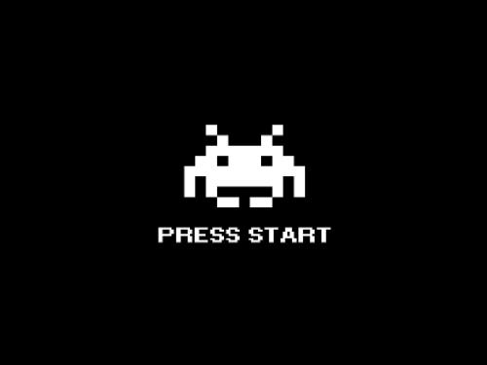
Theme
Arcade game:
Insert coin to continue…..
1 player or 2 player?
Controls?
Platform?

Slide 4

Requirements
Requirements arcade game:
Playable on the arcade machine in G 6.30
Platformer created with GxP engine
Begin screen
Game over screen
Player should be able to quit application

Slide 5

Planning
In the manual there are a couple of things stated…

Slide 6
Planning
The planning is divided in 3 different sprints:
1: Concept sprint
GE
GDP
2: Design sprint
GE
GDP
3: Production sprint
GE
GDP
Note, sprint 1 and 2 are both presented on Friday (or Thursday, depending on your schedule)

Slide 7
Sprint 1: Concept phase
Team work
Scrum sheet
Gameplay
Game sheet
Core mechanics
Paper prototype / Gameplay prototype
Conceptual level
GE:
Functional Design (screen flowchart)
Technical requirements
(Sample build)
Demo controls
GD
Mood board
Sketches (at least 20 p.p.) (rough!!! Max a couple of minutes per sketch!!!)
Concept art 2 to 3 worked out sketches, determining your style
Stylesheet
UI design
We are going to create a two player co-op game where the decisions of player 1 (god-view) decide the path for player 2 (3rd person top down)
Graphics should be a monochromatic cartoon style with 1 support color
Mechanics: Player 1 has a limited set of tiles. Time pressure is added by introducing a scrolling screen so that decisions of which tile to place have to be rather quick. Player 2 needs to jump over gaps, avoid certain tiles and make it to the end as quick as possible
Technical requirements: for the vertical slice we need - A scrolling screen - placement functionality of different tiles
- health / death system
- Start screen
- Quit functionality
- ……

Slide 8

What are the Pitfalls of the concept phase?

Slide 9
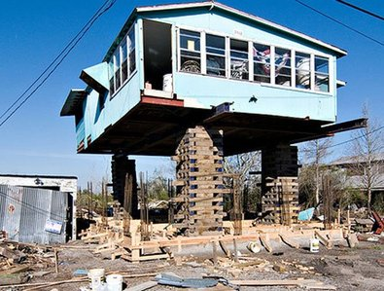
Pitdfall of the concept phase
Not taking enough time
Jump into conclusions / production
Since you are rather new to the process, it’s hard to estimate what is possible and what is not.
Ending up with your drafts as being the final product
Not testing your idea
Don’t build upon a bad foundation!

Slide 10
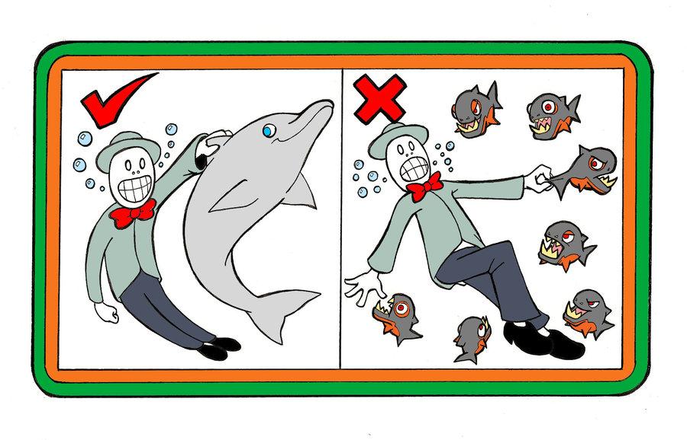
Tips and Tricks
Keep your laptop closed until basic concept is clear
(unless it is to take notes)
Get paper / pens and test stuff!
Generate a load of crap (diverging)
Do brainstorming (use 2d animation excel list)
See 2d animations, lecture 3
Your first idea is not your best idea!

Slide 11
Sprint 2: Design phase
Teamwork
Scrum sheet
Gameplay
Game rules
Playtest and feedback (from others!)
Mock up level
GE:
Workflow design
Technical prototype: Hardest / most unknown parts first
Basic level editor (notepad?)
Vertical slice (show all individual prototypes)
GD
Workflow design
Asset list
HUD design
Final art mockup
Style sheet final

Slide 12
Sprint 3: Production / polishing phase
Teamwork
Scrum sheet
Game design
Play tests
Polishing and publication
Scrum sheet
Pitch
GE:
Alpha build
Final test on arcade machine
Bug fixes
GD
Worked out assets, based upon asset list
Backgrounds
Characters
Tiles
Animations
Sound / music
Final menu

Slide 13
Planning: Scrum Sheet
The previous 3 slides need to be divided over 2 weeks
Make sure to make a sprint breakdown (use the 3 sprints in these sheets)
Assign leads (lead programmer, lead art, Lead Game design, Lead planning)
Set strict deadlines for these phases
Every deadline you miss, will break a piece of your final game)
Make decisions
Accept the fact that in the second day the game concept should be frozen, and is far from perfect

Slide 14

Workflow
How are you going to ‘meet in the middle’
Describe in a document:
Engineers are responsible for the outlines
Make it fool proof (not stating anything about the creatives here!)
Be as clear as you can be how you want the files and where
State technical details.
Creatives are responsible to meet these outlies
Name conventions
File formats
Work precise!
Make back-ups
Take your responsibility
Game design
Level editor? Who is making the editor?
Who is building the levels?
Who is testing the levels?

Slide 15

Vertical slice
The combination of all prototypes you’ve made (technical)
Player can jump
Player can collide
Player responds to controller input
Player can die
Player can respawn
Etc….

Slide 16
Asset list
The asset list is the ‘vertical slice’ for the creatives
Once the lead artist set the style and described it,
the rest of the creatives should have a guideline to work towards (production phase) (see exercises 2d animation and 2d game assets)
The asset list shows which props need to be in the game and which ones are nice if there is time left
Description | Tech requirements | Name | Animations | Priority
Main character | .png 512 x 512 max Transparancy | playerSprite.png | Idle Jump Walk | Must have
Building block step stone | In main spritesheet (.png, 2k max) Resolution: 64 x 64 | SpriteSheet | none | Must have

Slide 17
MoSCoW
Let’s fill these in:
Must have
Should have
Could have
Wont have

Slide 18
Last year example

Slide 19
Groups

